Slide 1
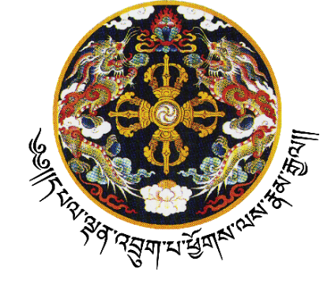
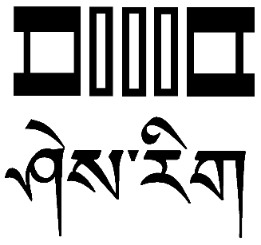
དཔལ་ལྡན་འབྲུག་གཞུང་།
ཤེས་རིག་དང་རིག་རྩལ་གོང་འཕེལ་ལྷན་ཁག།
Royal Government of Bhutan
Ministry of Education and Skills Development
Cover Page
Education Vision: "Empowering 21st century learning rooted in Bhutanese values of tha dam-tsig ley gju-drey and guided by the development philosophy of Gross National Happiness (GNH), harmonising academic excellence with holistic well-being, cultural identity, and sustainable citizenship”.

